Slide 1
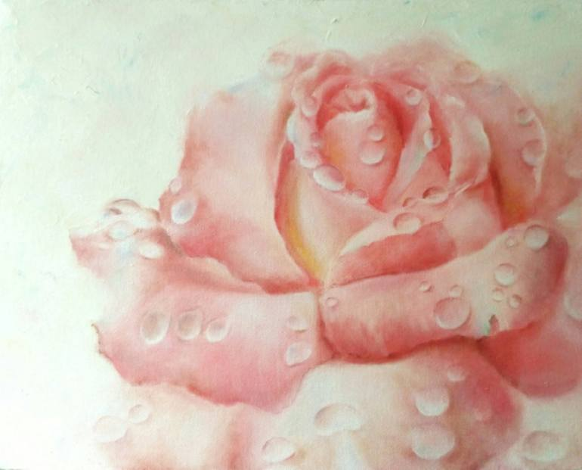
Rose Basics – Use Water!
Bill Farmer
Master Rosarian

Slide 2
Several Ways We Use Water
Perform DIY soil tests
Hydrate new plants
Maintain optimum moisture
Discourage pests
Prepare pesticides and fertilizers

Slide 3
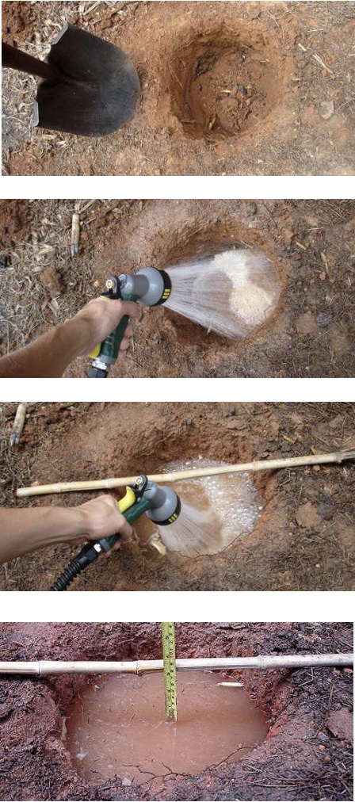
Soil Percolation Test
Dig a hole
Fill with water
Let it drain
Refill with water
Measure water level hourly
Determine average hourly drainage rate

Slide 4
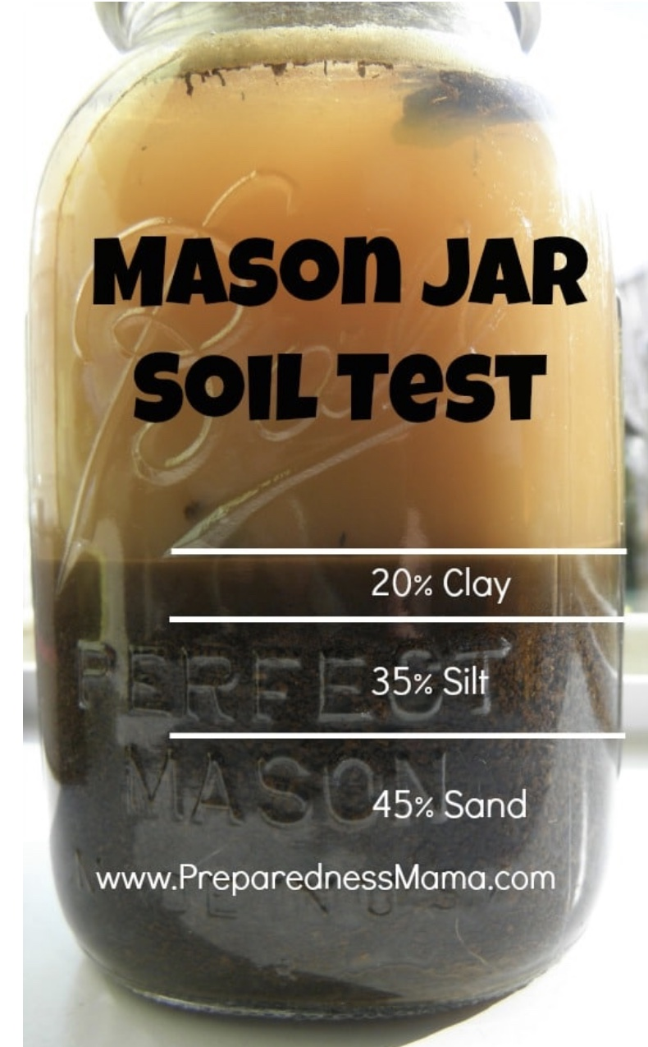
Soil Texture Test
Fill clean jar about half full of garden soil
Fill with water – leave room for shaking
Let stand
Read results
Determine percentages of sand, silt, and clay
Identify soil type on soil texture triangle

Slide 5
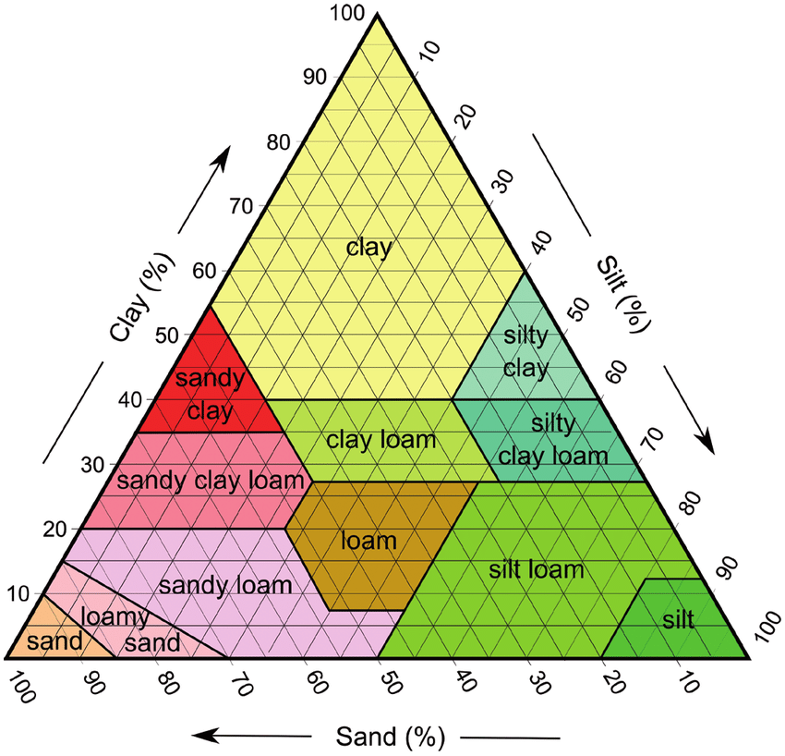
Soil Type

Slide 6
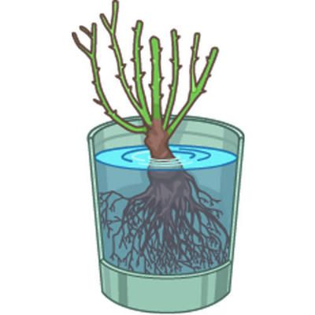
Water Before Planting
Soak bare root rose plants
Ensure fully hydrated
Consider soaking potted rose plants
Submerge in large container
Hose off the planting medium;
proceed as with a bare root rose plant.

Slide 7
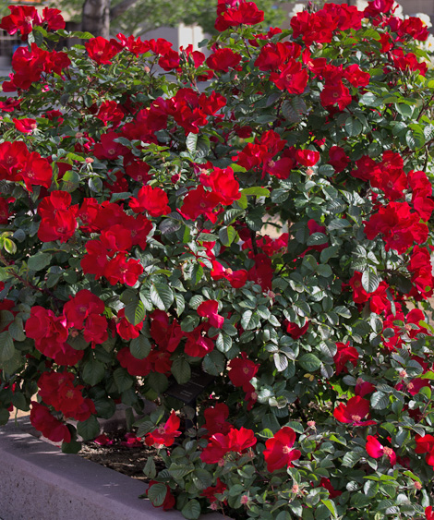
Roses Need Water
Vital to all plant processes
Nutrient uptake
Cell development
Temperature regulation
Essential to grow to their fullest
Healthy bush
Vibrant blooms
Rich color

Slide 8
How much water do roses need?
depends on
soil condition
four to five gallons per week
depends on temperature
gallon for each foot of height
depends on
exposure to elements
one to two inches per week
Water regularly, deeply, infrequently.

Slide 9
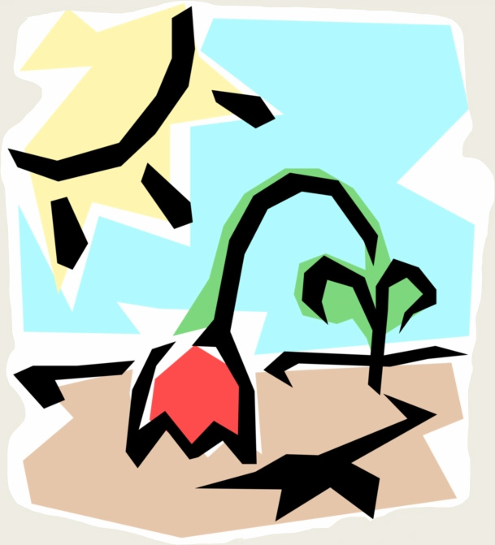
Know When Roses Need Water
New stems and foliage look a little droopy
Soil is dry a few inches below the surface
Indicator plants (e.g., impatiens) begin to wilt
Leaves lose their sheen or appear wilted
Use a moisture probe.
Notes:
Quick example of basic conversion of fraction to decimal

Slide 10
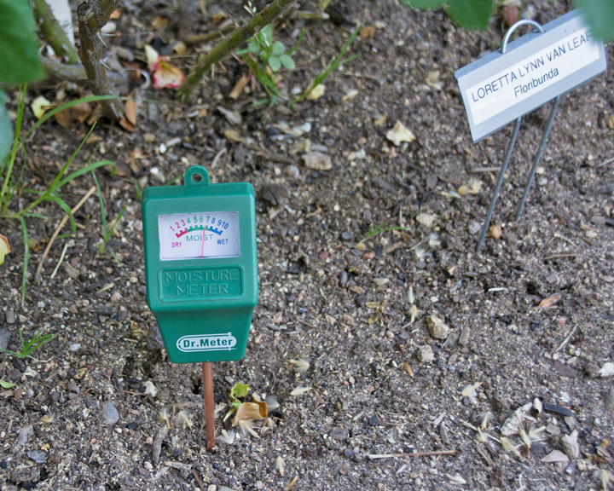
Moisture Meter
Notes:
Quick example of basic conversion of fraction to decimal

Slide 11
Over Watering Roses
Almost impossible . . . with good drainage
But . . . roses do not like their feet wet
Waterlogged roots cannot access oxygen
Lower foliage begins to turn yellow and drop

Slide 12
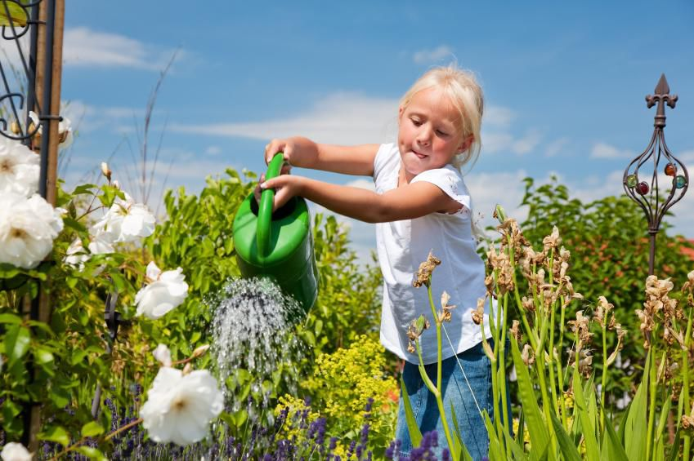
Rose Watering Methods
Hand water (watering can, bucket, hose)
Enjoy your garden
Check for pests
Direct water to soil
Any time of day
Might be time consuming
Could be hard work
Difficult to know how much
Determine time required to apply a gallon of water.

Slide 13
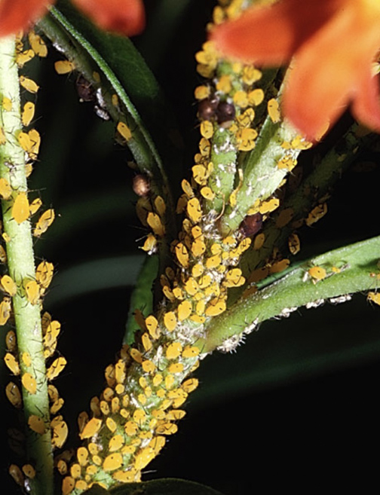
Water Blasting Pests

Slide 14
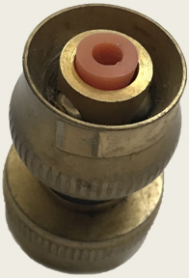
Helpful Tools

Slide 15
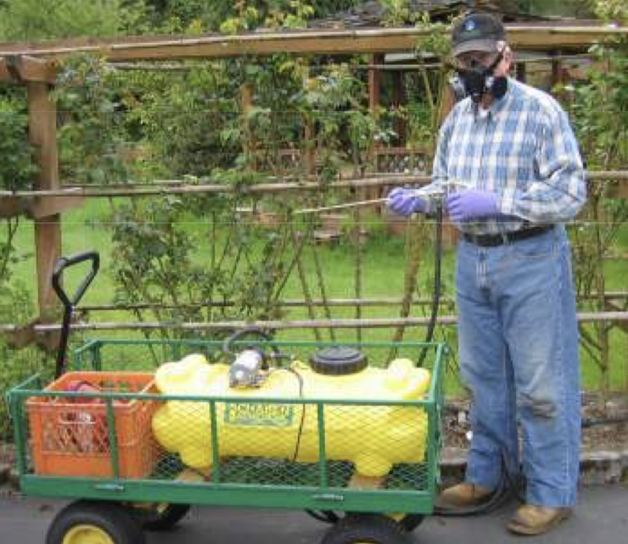
Use Pesticides Properly
Identify the problem
Select the proper product
Read the label!
Protect yourself with proper PPE
Mix the pesticide properly
Follow proper procedures
Read the Label!

Slide 16
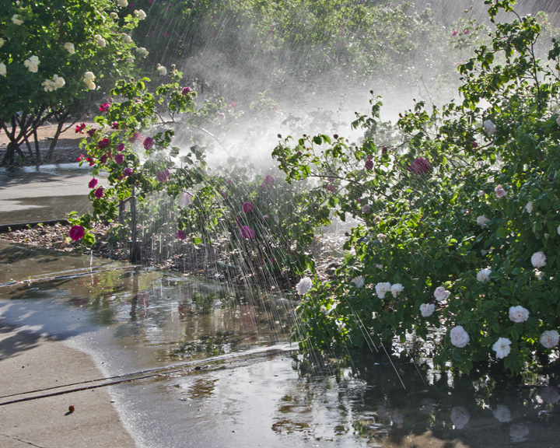
Rose Watering Methods
Pop-up sprinklers
Relatively uniform application
Generally easily automated
Less efficient than hand watering
Hard water deposits
Time of day constraints
Pictures of sprinklers
Watch for rose plants blocking water.

Slide 17
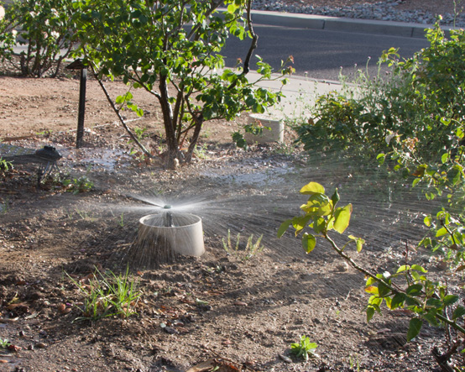
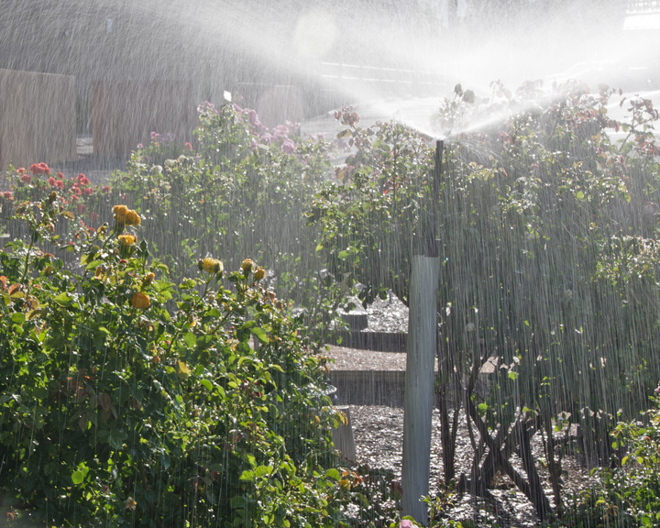
Pop-up Sprinkler Alternatives
Go High
Go Low

Slide 18
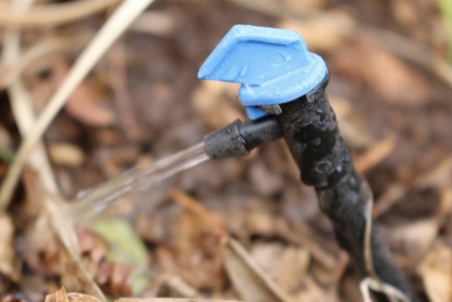
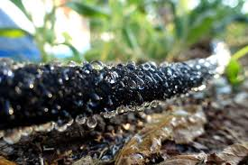
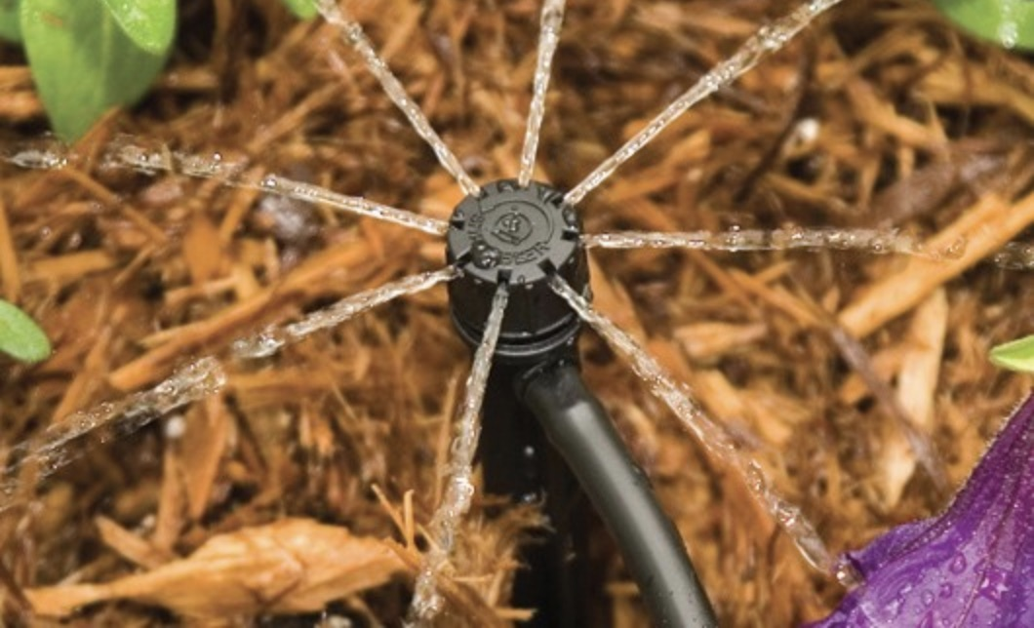
Rose Watering Methods
Micro-irrigation (emitters, soakers, sprinklers)
Direct application of water
Adaptable to topography
Less evaporation loss
Slow, deep penetration
Any time of day
More components
Susceptible to plugging
Require monitoring

Slide 19
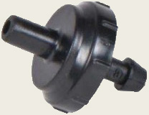
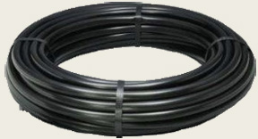
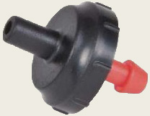
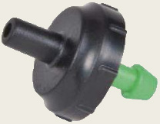
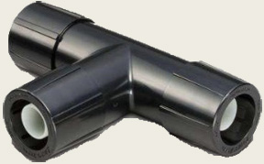
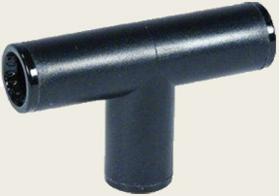
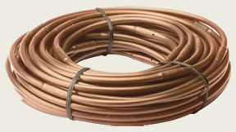
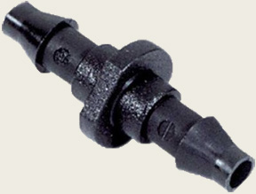
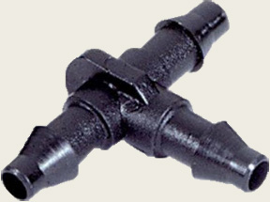
Micro-irrigation Components
Distribution Tubing
Emitters
Micro Sprayers
Connectors
Dripline

Slide 20
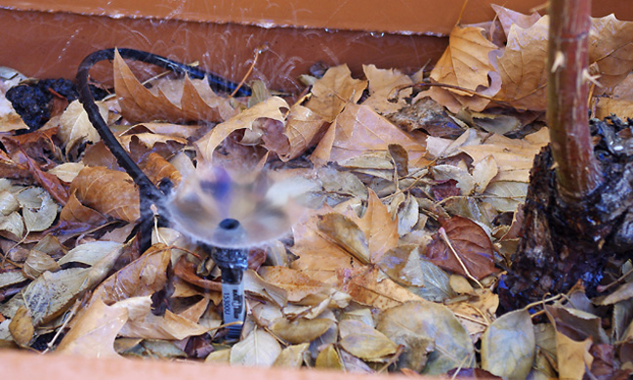
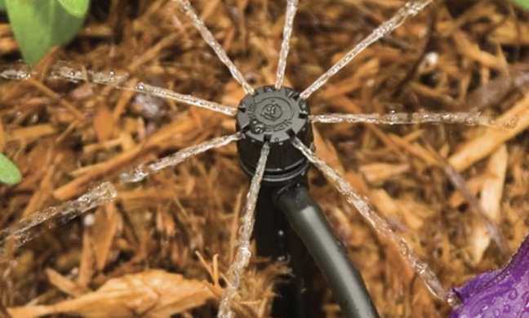
Micro-irrigation Sprayers

Slide 21
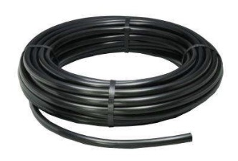
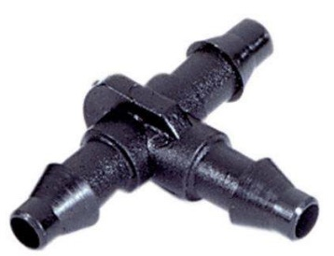
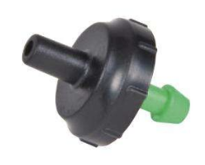
Micro-irrigation TIPS
Tubing
Unroll and allow to warm in the sun
Cut with sharp pruning shears or tubing cutter
Lay out longer lengths than you think you need
Connectors
Wear rubber gloves that grip
Lubricate with diluted dishwashing liquid
Emitters
Use a quality punch made for irrigation tubing

Slide 22
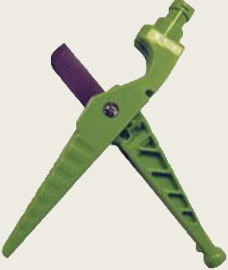
Helpful Tools

Slide 23
Micro-irrigation System Maintenance
Monitor all components regularly
Flush the system periodically
Check and clean filters regularly
Monitor emitters for correct output
Replace clogged emitters rather than attempt to clean them.
Adjust micro-sprinkler spray direction and distance
Drain the system before extreme cold weather
Replace batteries in controllers annually
Keep spare emitters, micro-sprinklers, connectors handy.

Slide 24
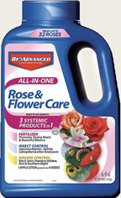
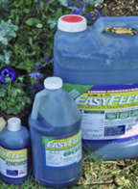
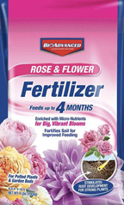
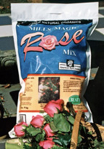
Fertilize Roses
Water before fertilizing
Avoid nitrogen burn
Mix water soluble products properly
Water after fertilizing
Maintain adequate soil moisture

Slide 25
Final Thoughts
Water regularly, deeply, infrequently
Water effectively and efficiently
Water early in the day
Consider water blasting unwanted pests
Be careful mixing toxic substances
Keep roses hydrated in the fall and winter

Slide 26
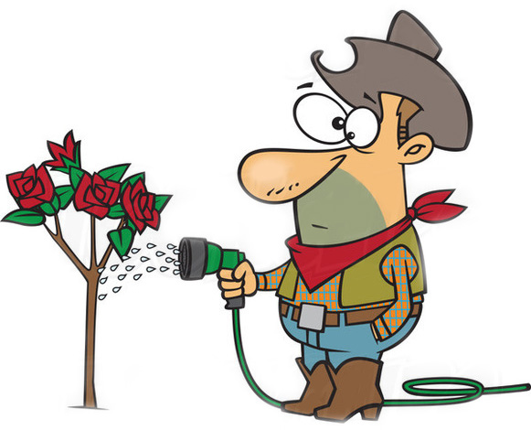
Thank You and Enjoy Your Roses

