Slide 1
The American Rose Society’s
Kidz N’ Roses
Presents
Roses Rock!

Slide 2
What is the Roses Rock! Program?
Roses Rock! is a series of rose horticulture lessons offered free-of charge to children everywhere. The program contains:
Colorful PowerPoint presentations
Adaptable lesson plans for multiple grades
Hands-on activities that reinforce the learning process
Rose Crafts

Slide 3
Current Lesson Topics
(with more to come)
Rose Hybridization (creating new roses)
Rose Propagation (cloning existing roses)
Sustainable Gardening with Earthkind Roses
Bug Buddies (beneficial insects for roses and the companion plants where they live)
Going Green (composting for bigger blooms)
Rose Classifications
Uses of the Rose throughout History
( in art, science, food and medicine)

Slide 4
Roses Rock! lessons are prepared by rosarians, teachers and master gardeners
Individuals from all walks of life are helping to contribute to our Roses Rock! lessons
Hundreds of years of combined rose wisdom are being compiled and organized into lesson formats that appeal to children and are user friendly for those who share them

Slide 5
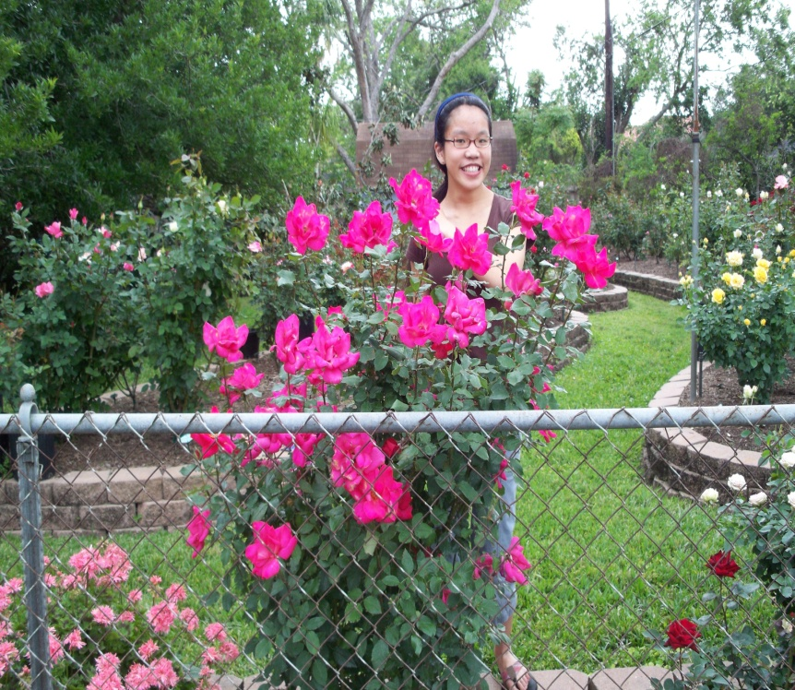
Some of our powerpoint lessons are presented by Young Rosarians
Our Roses Rock! PowerPoint features a fifteen year old hybridizer who is on a passionate quest to unlock the genetic code that will produce the first truly blue rose.

Slide 6
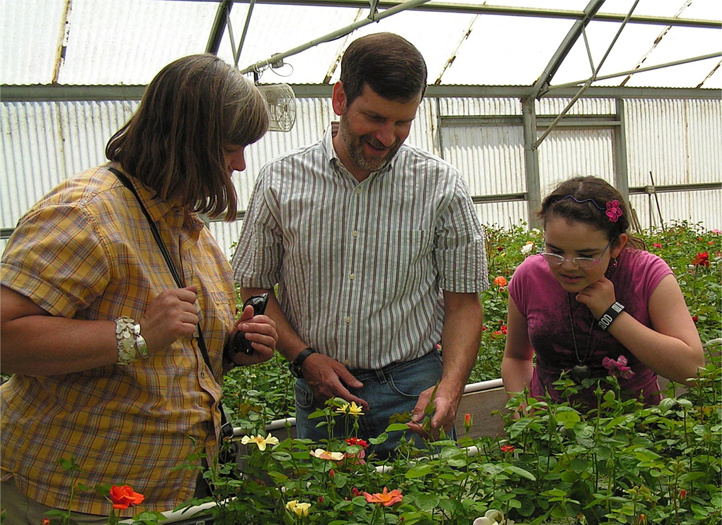
Roses Rock! helps students learn through hands-on experience

Slide 7
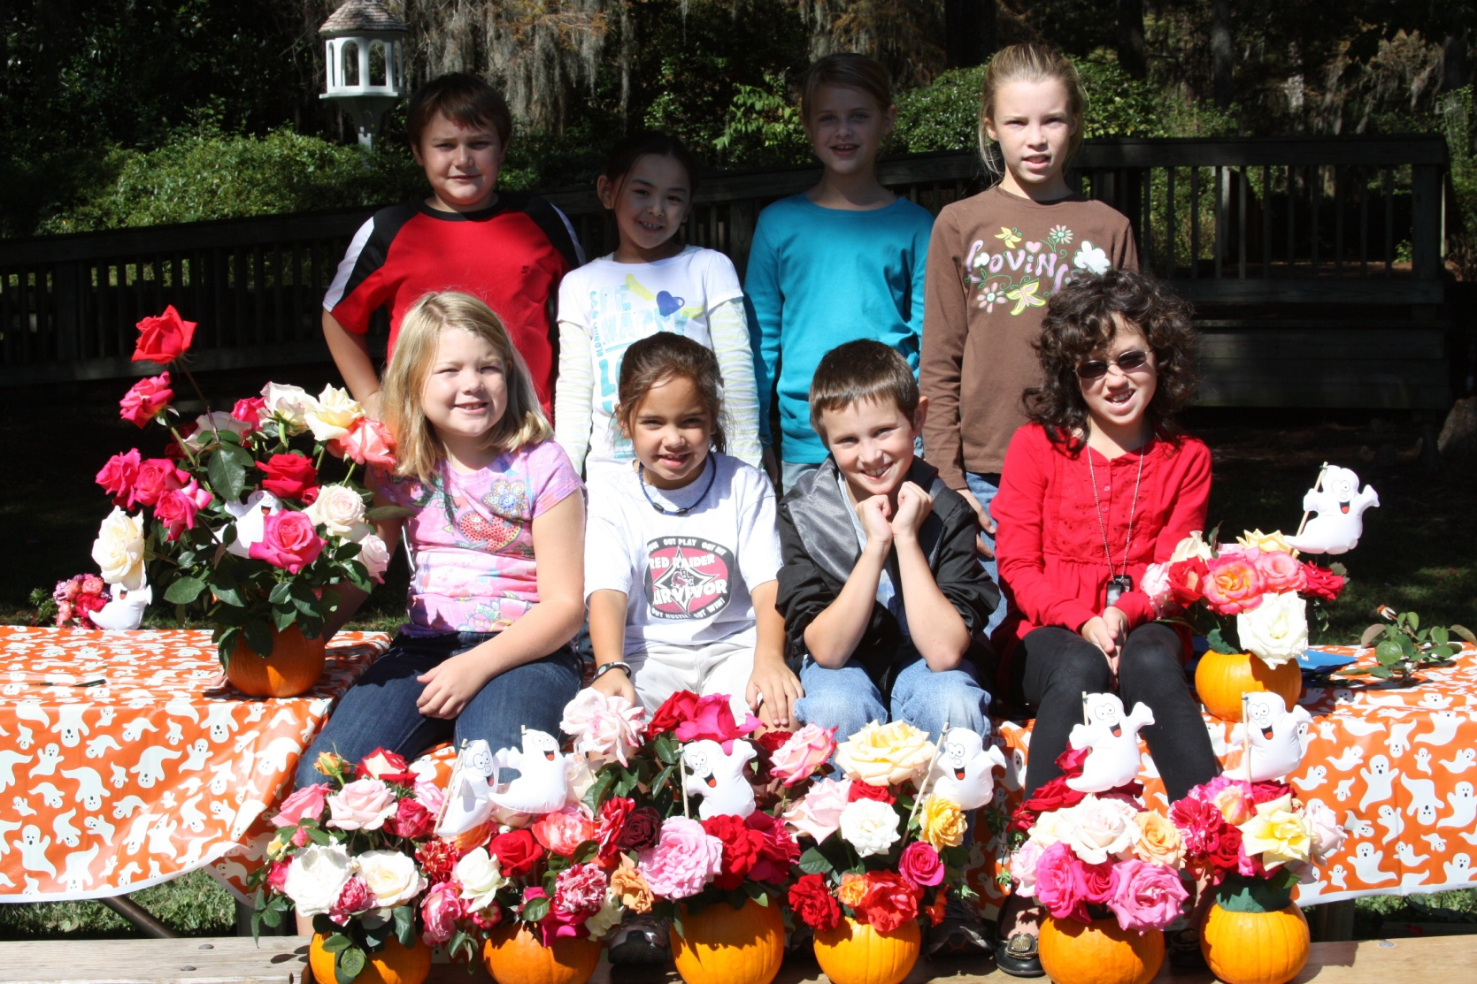
Roses Rock! helps students learn through arts and crafts and fun!

Slide 8
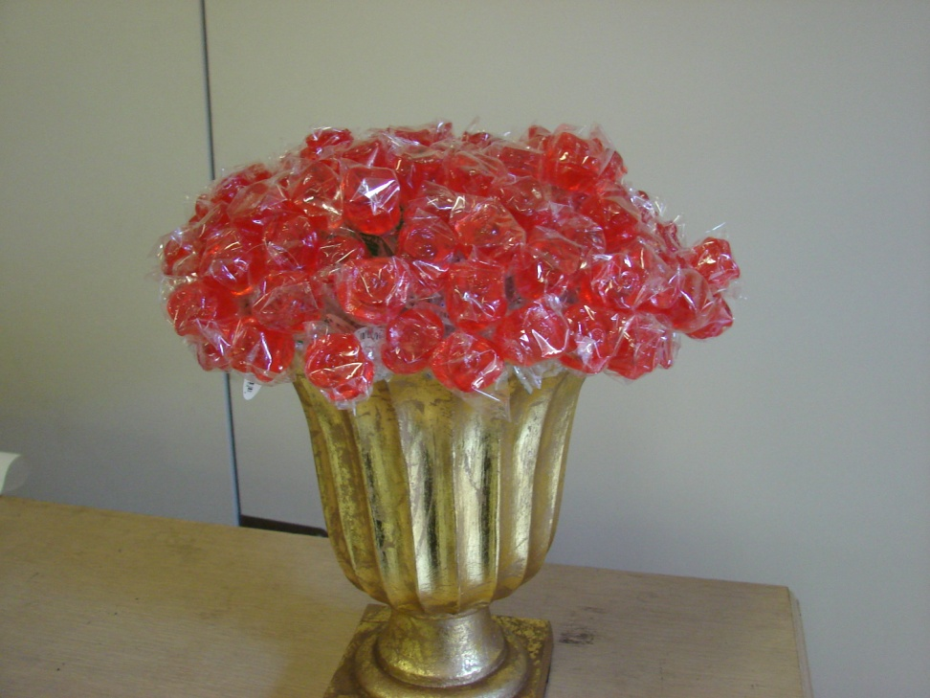
Reinforcing the lessons learned
Students always have something to take home with them…
Information Packets
Arts or Crafts
Worksheets
Rose Cuttings
Rose Bush
Kidz n’ Roses Membership Applications

Slide 9
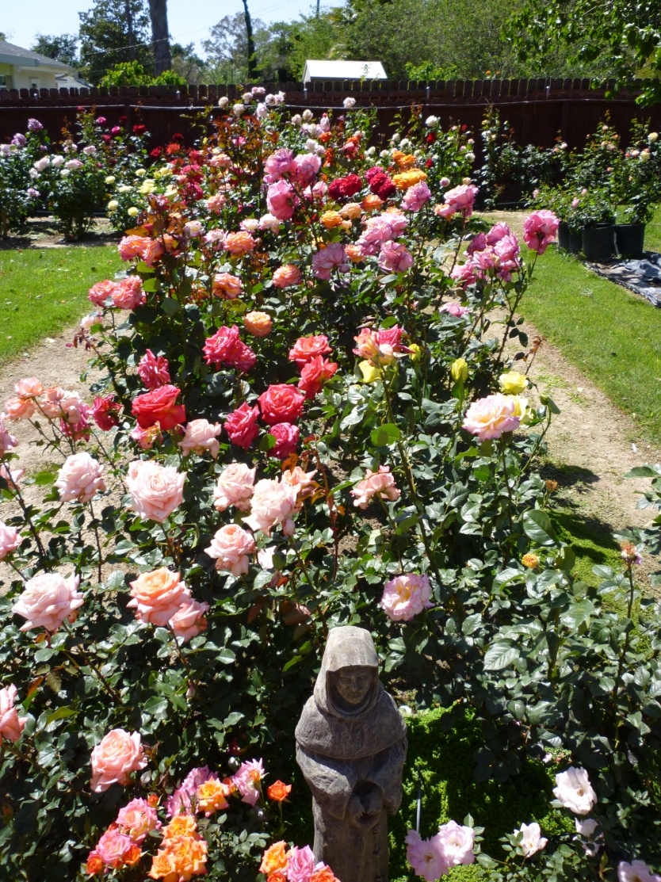
Where can these lesson be taught?
Rose Societies
Elementary Schools
Middle Schools
Boy Scouts
Girl Scouts
4-H Clubs
Community Centers
Back Yards
Community Rose Gardens

Slide 10
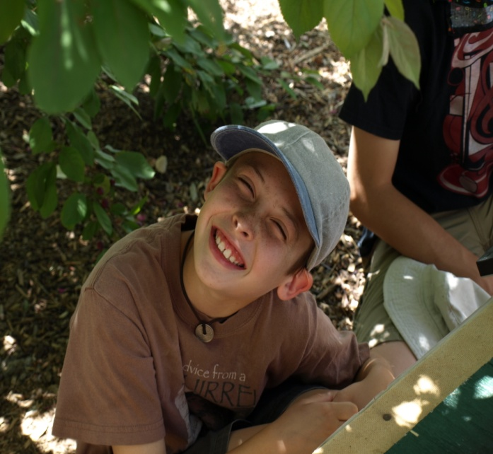
Who can teach these lessons?
Parents
Grandparents
American Rose Society members who are avid rose enthusiasts and have a desire to introduce children to the wonderful world of roses.
“The children we teach today may become the rosarians of the future”

Slide 11
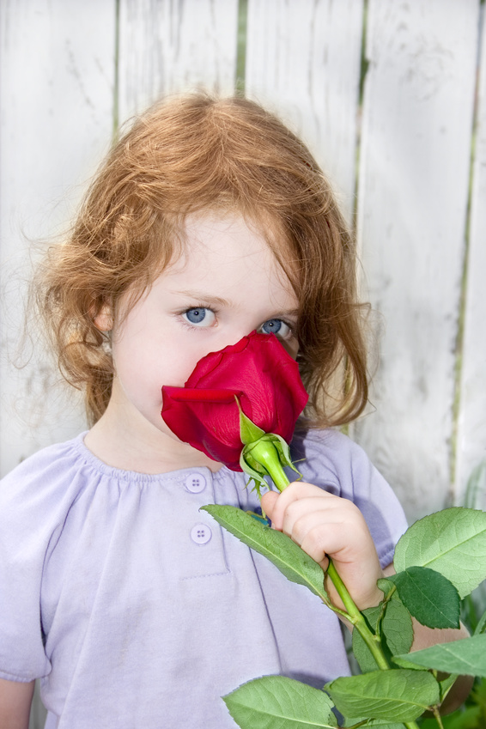
Teaching children can benefit your Local Rose Society… and the ARS
Teaching children will help your members keep a “youthful” focus on life
Children who learn to love roses, love to share their knowledge with their families and friends…who are potential members
Children can develop a purpose and passion for knowing and growing roses that enriches their lives and those around them

Slide 12
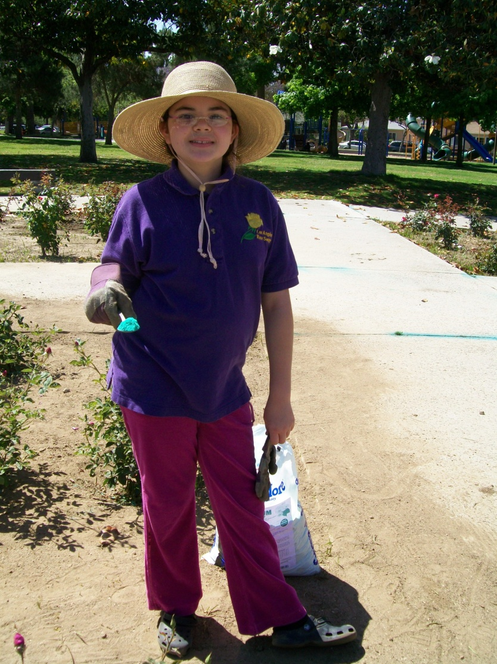
Roses Rock! helps students give back to our communities
Community Gardens are always in need of volunteers who are well trained in rose horticulture like Cordelia
She has given her time, help and enthusiasm to benefit her home town

Slide 13
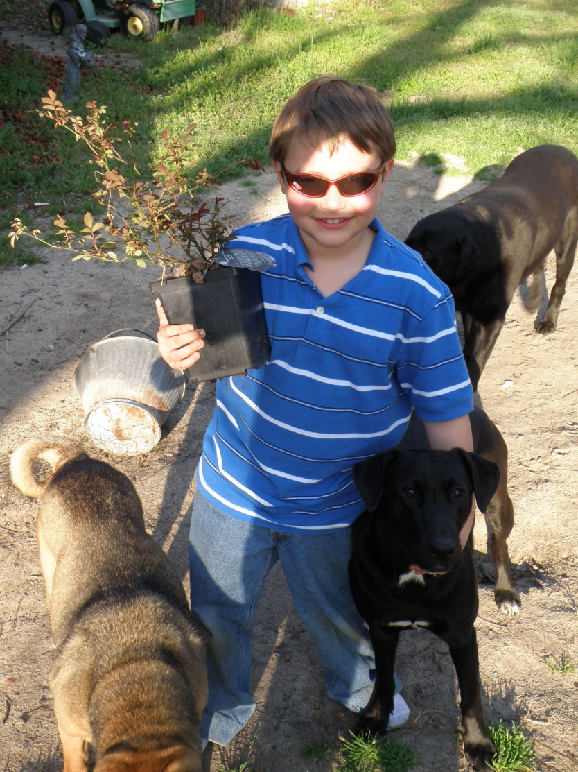
If you cannot teach what can you do to interest children in roses?
Purchase a $10.00 annual membership in Kidz N’ Roses for the children you know
Encourage them to share with you the things that they learn from our newsletter
Encourage your society to include activities for children at your meetings
Buy them a rose to plant

Slide 14
An ARS Kidz N’ Roses Membership helps extend the learning process
Kidz N’ Roses
E-Newsletter
This publication is packed full of:
Educational Articles
Crafts
Word Searches
Colorful Photos and Graphics.
It is currently a quarterly publication with plans to publish more frequently
Kidz N’ Roses Membership offers
Membership Card
Newsletter
Essay Contests
Web Pages at ars.org

Slide 15


Give the Gifts that brings such joy!
Roses, love and knowledge

Slide 16
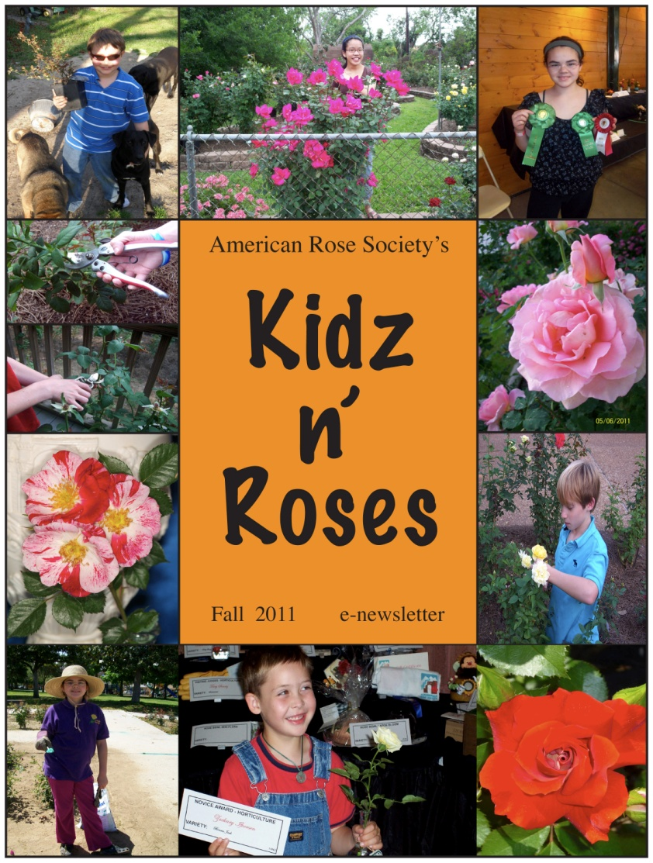

The New Look for Our E-Newsletter

Slide 17
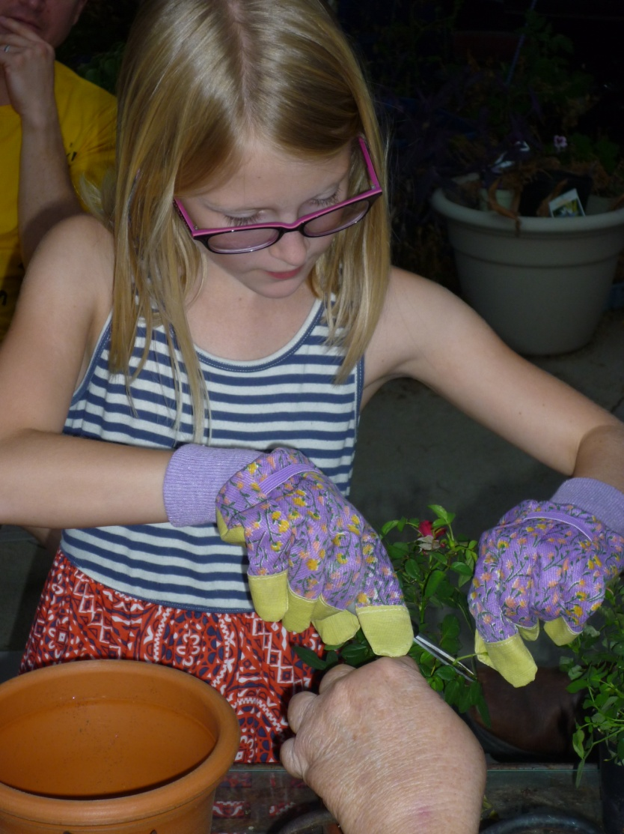
Where to find our Roses Rock!
“Tools for Teaching”
Power Points and lesson plans will be available for download beginning in January 2012
on the
American Rose Society website www.ars.org
Questions? We would love to help you
Contact us at:
kidznroses@ars-hq.org

Slide 18

The Lessons will soon be ready
The Possibilities are endless with….

