Slide 1


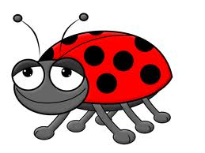
Kidz N’ Roses Presents
The Good-The Bad and The Bugly

Slide 2
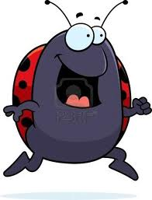

The Good-The Bad and the Bugly
Who’s Bugging Your Roses?

Slide 3
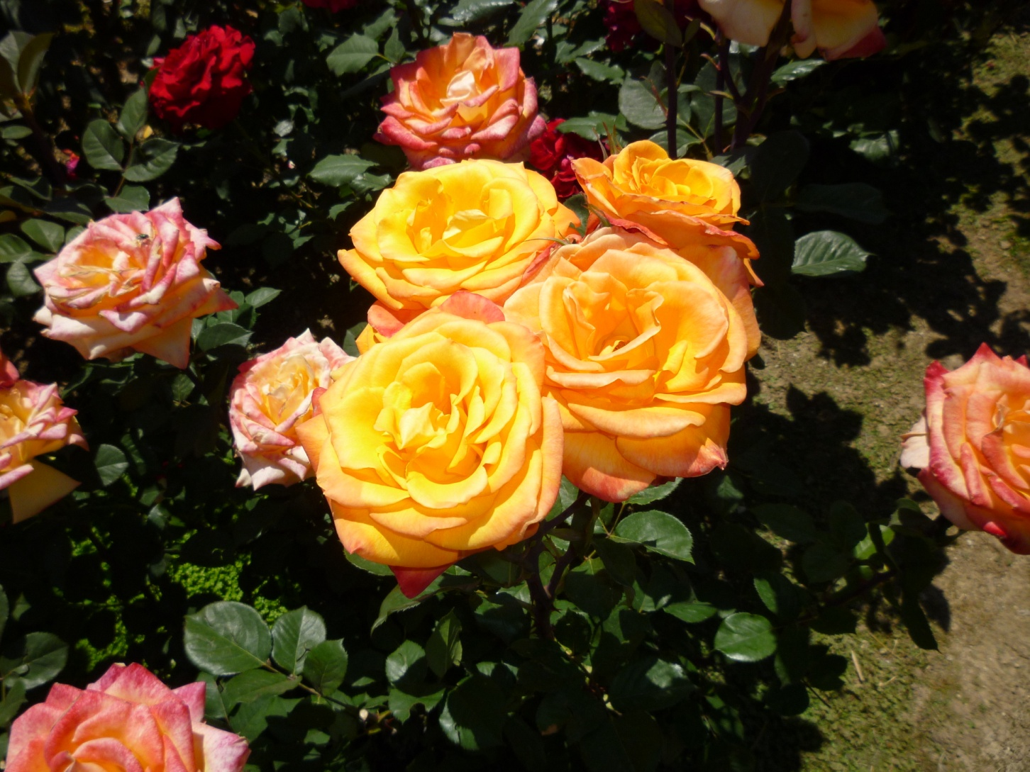
Most People Love Roses

Slide 4
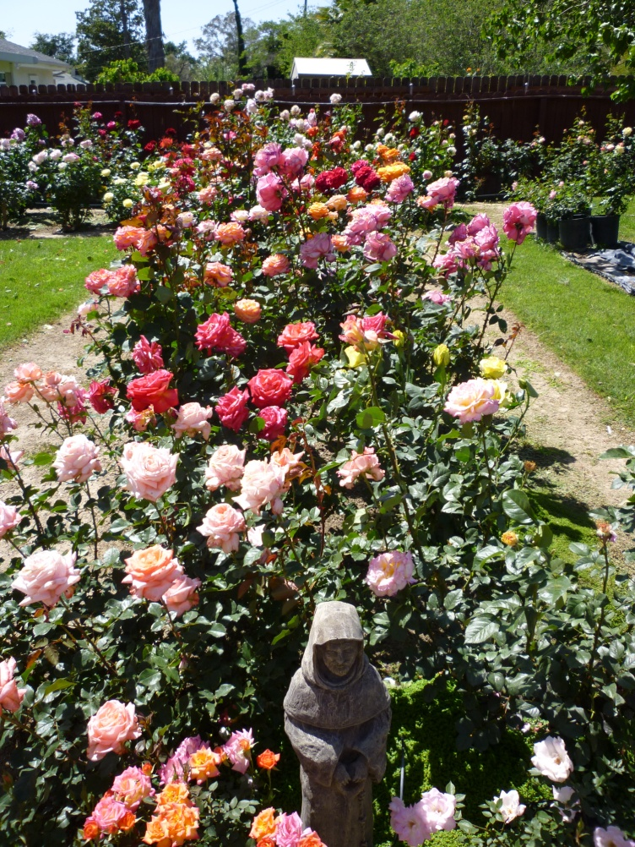
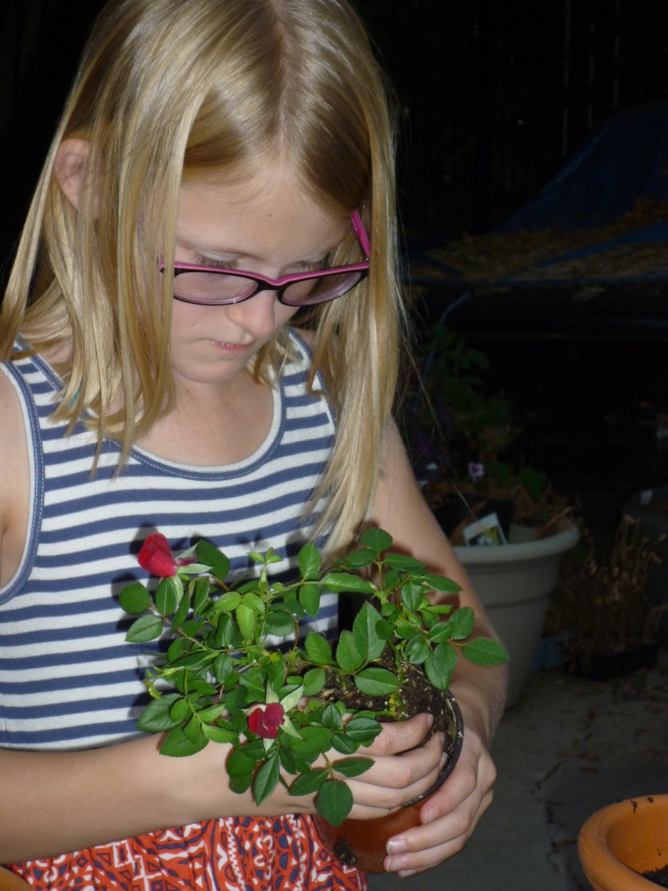
They Love to…
Plant Roses in a Garden
Plant Roses in Containers

Slide 5
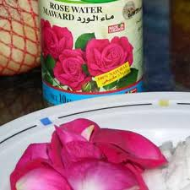



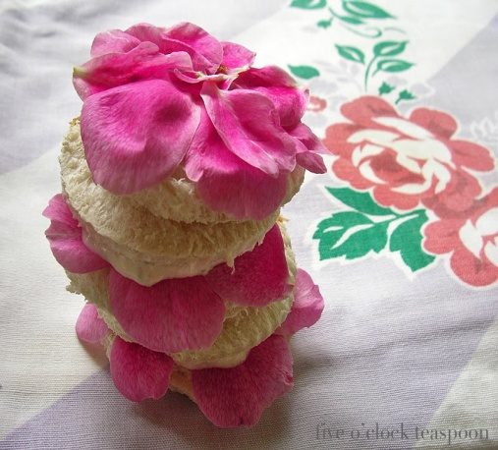
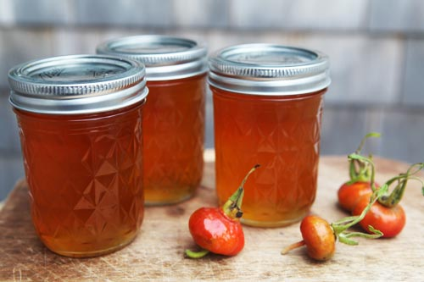
Some People Love to Eat Roses
(They must be grown without chemicals)

Slide 6
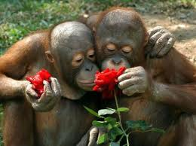
Many Animals Love Roses Too

Slide 7
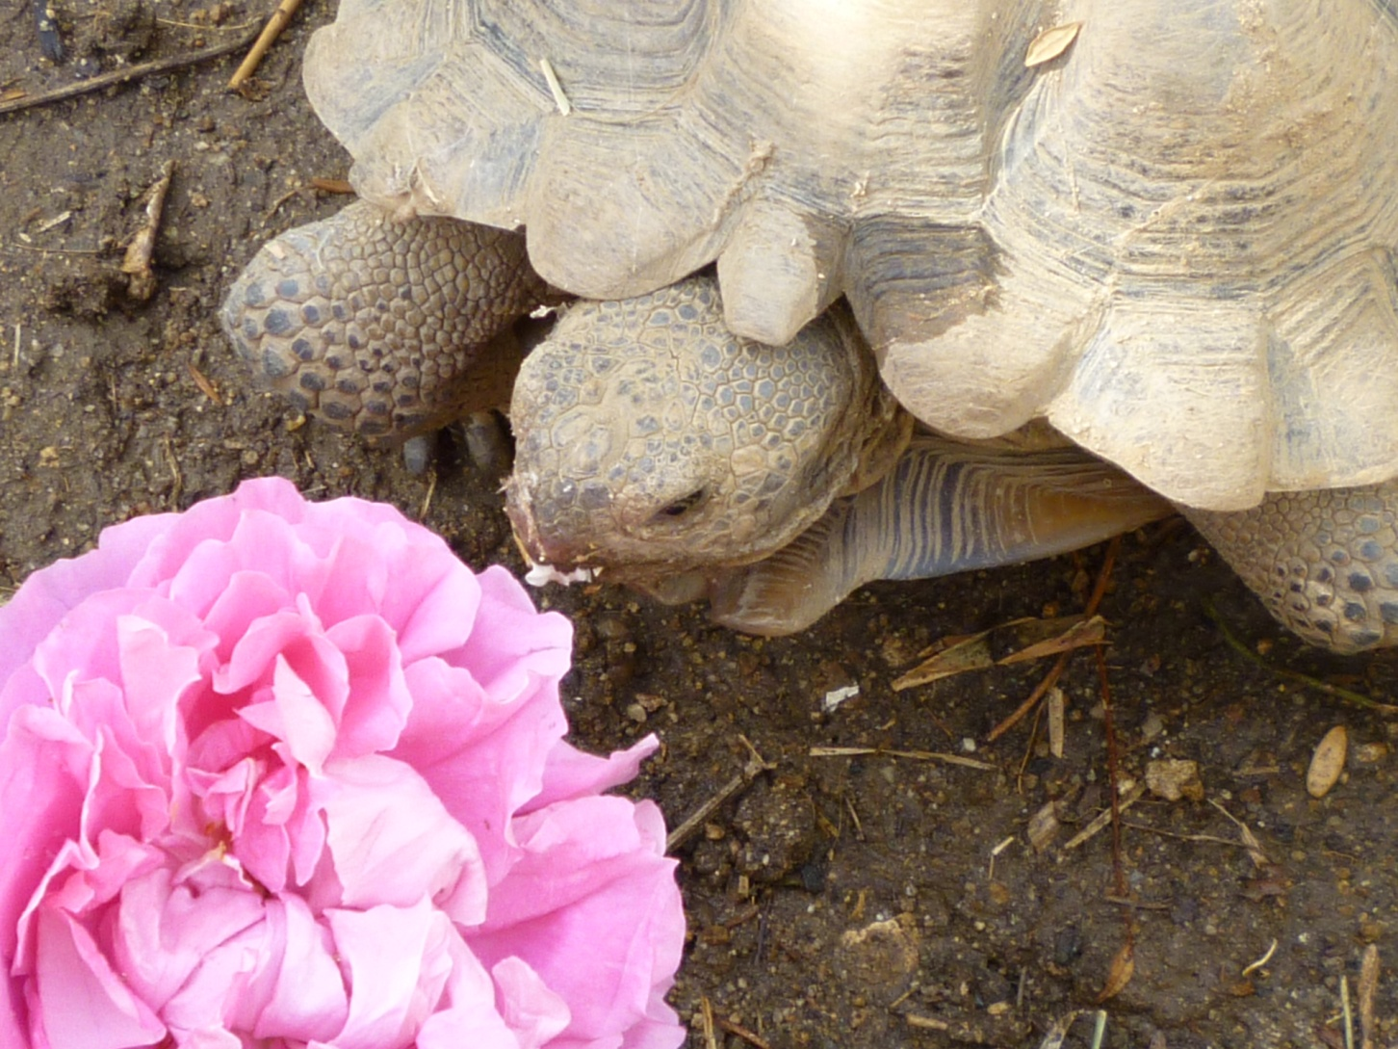
This Tortoise Loves Roses for Lunch

Slide 8
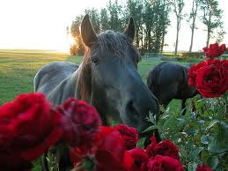
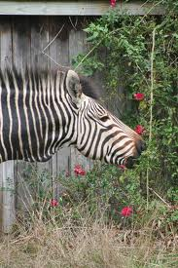
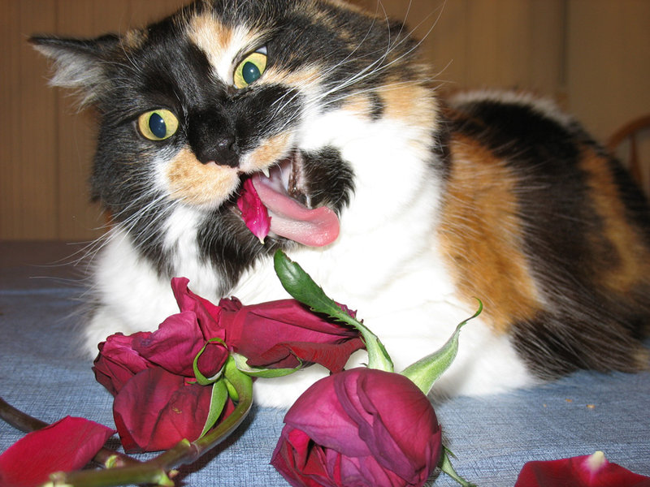

All Kinds of Animals
Love to Nibble Roses

Slide 9

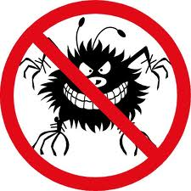
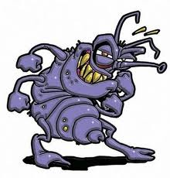
Many Different Types of Bugs Love Roses
    Some bugs are beneficial to roses and other garden plants. They love roses in a healthy way.
    (THE GOOD)
    Some bugs harm and can destroy roses.
    These bugs “love” roses in a destructive way.
    (THE BAD)
    Some bugs in the rose garden are really strange in appearance. These bugs may be beneficial or harmful to roses, but they really are…
    (THE BUGLY)

Slide 10
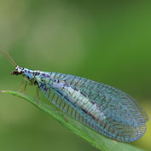
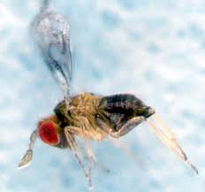
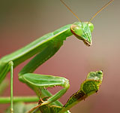
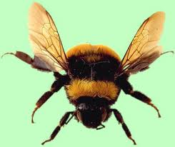
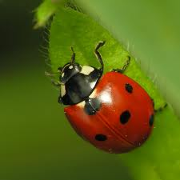
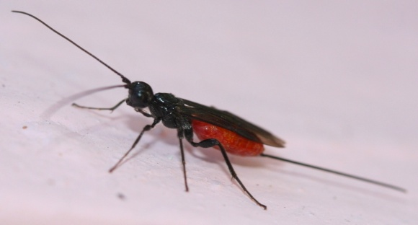
Meet the GOOD Guys
Preying Mantis
Lacewing
Trichogramma Wasp
Bee
Lady Beetle
Braconid Wasp

Slide 11
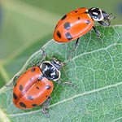
What do Lady Bug Beetles do?
Predatory Lady Bug Beetles are about ¼ inch in size. They are primarily known as predators of aphids.
During its full life cycle, a single adult Lady Beetle may devour more than 5,000 aphids.
Using pesticides in your rose garden will destroy these Good Guys.
Lady Bug Beetles
Definition: Predatory-Living by preying upon other animals.

Slide 12
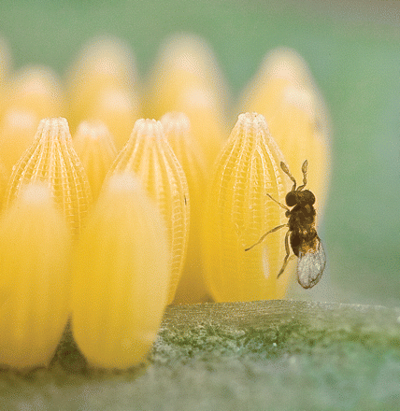
What do Trichogramma Wasps do?
These wasps serve double duty as defenders for roses.
They work as *pollinators, which helps promote more blooms.
They prey on the eggs of more than 200 worm-type pests.
The wasp lays its eggs inside the pest’s eggs, killing the eggs as they hatch.
They are very effective at killing borers and moth caterpillars.
As soon as these wasps mature they fly off in search off more eggs to invade.
*Definition: Pollinators are insects or other agents that transfer pollen from one plant to another.
Trichogramma Wasp

Slide 13
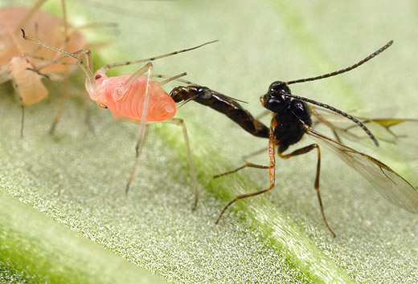
What do Braconid Wasps do?
These wasps are ½ inch or less in size.
They are *parasitic.
They lay their eggs inside the body of other pests.
They attack corn borers, sawflies and all sort of larval pests.
*Definition: Relationship between two organisms in which one obtains benefit at the expense of the other
Braconid Wasp Laying an Egg Inside an Aphid

Slide 14
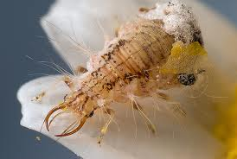
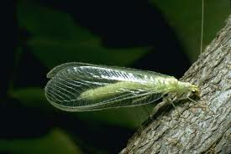
What do Lacewings do?
Lacewing larvae are active predators. They have well developed legs.
They also have large pincers with which they use to suck the body fluids from their prey.
They love to feast on Thrips, the eggs of Leaf Hoppers, and Spider Mites.
The larvae are sometimes called Aphid Lions. They can eat between 100-600 aphids each as they mature.
Lacewing adults feed on nectar and pollen.
Green Lacewing Larvae
*Definition: Pincers are an organ or pair of organs resembling a tool for gripping and holding tight.
Green Lacewing Adult

Slide 15
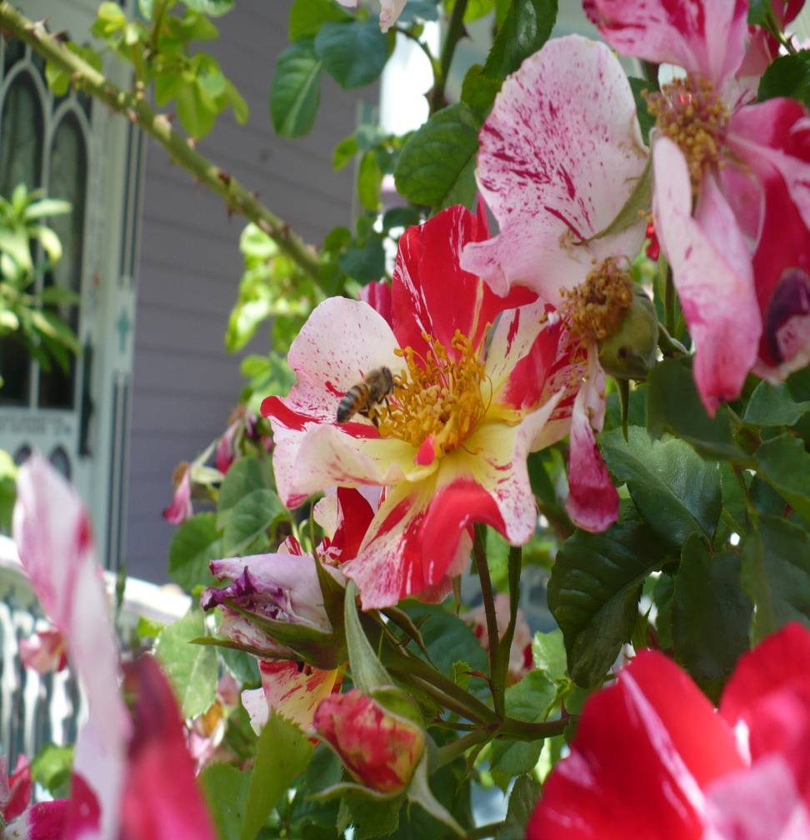
What do Bees do?
Bees love to fly from flower to flower.
They carry pollen on their bodies and feet.
Cross-Pollination encourages production of blooms in your roses and other flowering plants.
Bee on a Fourth of July Rose

Slide 16
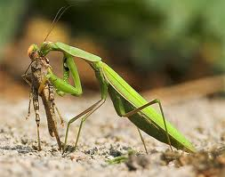
What do Preying Mantis do?
The Preying Mantis has a stick-like body and a huge appetite!
It is a predator.
It will eat any insect that walks, crawls or flies in the garden.
Most gardens have enough insects to keep a Preying Mantis well fed.
Preying Mantis Eating a Grasshopper

Slide 17
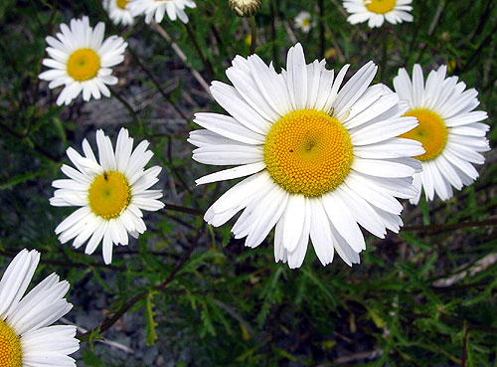
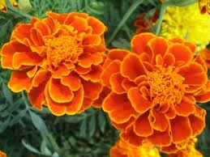
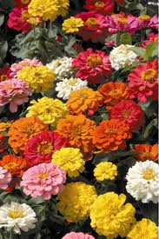
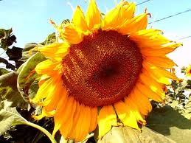
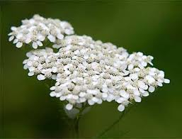
How to Attract Beneficial Bugs to Your Roses (and your garden)
Beneficial Bugs need a consistent food source, especially nectar and pollen, water, and shelter.
Plant flowers in your garden that will feed the Beneficial Bugs like;
Daisy
Marigold
Zinnia
Yarrow
Sunflower

Slide 18
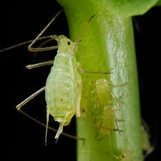
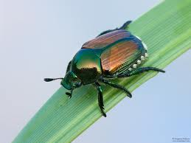
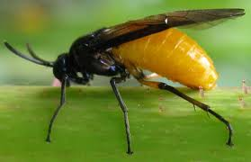
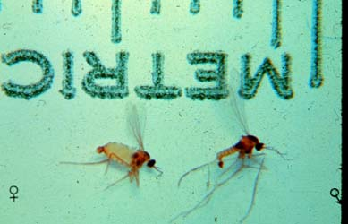
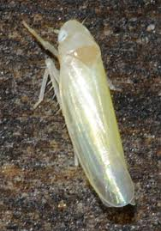
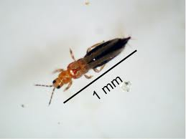
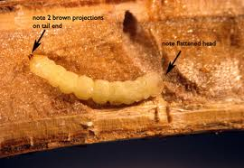
Meet the BAD Guys
Japanese Beetle
Sawflies
Aphids
Rose Midge
Thrips
Rose Cane Borer
Rose Leaf Hopper

Slide 19
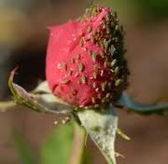
What do Aphids do?
Aphids puncture the soft tissue of a rose or garden plant and suck out the juices.
Severe infestations will cause leaves to curl up and die.
As they feed, aphids excrete a sticky substance that attracts ants and can cause mold or fungus to grow over time.
Aphids Eating on a Rose
.
*Infestation -Trouble or disturb frequently in large numbers.

Slide 20
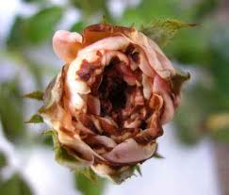
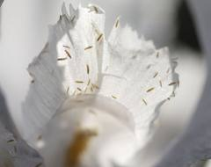
What do Thrips do?
Thrips often choose rose buds that are just ready to open.
They either keep the bud from opening or distort the rose blossom once it opens.
They create yellowish, brownish, white or black lines and spots.

Slide 21
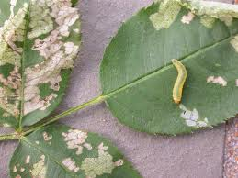
What do Sawflies do?
Adult Sawflies are a small non-stinging type of wasp.
The adults are not a problem, but their larvae are.
The larvae are called Rose Slugs.
They eat the rose leaf from the underside.

Slide 22
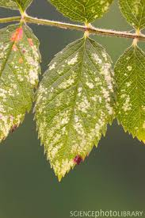
What do Rose Leaf Hoppers do?
The Rose Leaf Hopper feeds on the underside of the rose leaves.
They can cause extensive damage and make the leaves fall off.
Their piercing- sucking mouthparts drain the plant juices causing curling and discoloration of the leaves.

Slide 23
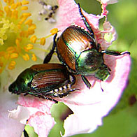
What do Japanese Beetles do?
Japanese beetles can eat entire roses and their leaves.
They especially love the paler colored blooms.
They do not kill the rose bush but they do great damage.
They usually eat the rose from the top down.
Japanese Beetles Devouring a Rose

Slide 24
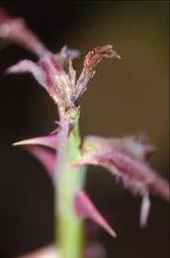
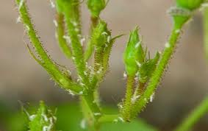
What does a Rose Midge do?
The Rose Midge is very tiny and feeds on the tender new growth and buds of roses.
The females lay their eggs inside the sepals of flower buds and rose tips.
The larvae then hatch and damage the buds and tips.
When they leave the buds and tips wither, blacken and die.
Definition: Sepal - One of the leaf-like parts that make up the calyx of a flower. They are usually green and cover the un-opened bud.

Slide 25
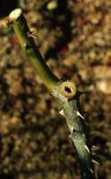
What do Rose Cane Borers do?
Cane Borers are the larvae of Sawflies, Carpenter Bees, and some wasps.
These pests lay their eggs on the freshly pruned stems of roses in late spring or early summer.
The eggs hatch and the larvae bore and eat their way into the center of the plant down the length of the cane.
This can kill the cane as far as the borer goes.
*Definition: Larvae -The wormlike early form of an insect.
Damage by Rose Cane Borer

Slide 26
How do You Help the GOOD Guys Control the BAD Guys- Without Harsh Chemicals?
Aphids- A blast of water from the garden hose every morning can help remove aphid infestations. You must do this every day until they are gone.
Thrips- Cut off (and remove from the garden) any infected buds as soon as you see any evidence of thrips.
Sawfly Larvae- Pull off all infested leaves and smash the larvae-throw the leaves and squished insects in the trash can.
Japanese Beetles-Early in the morning or late in the evening shake or pick the beetles off the bush and drop them into a bucket of soapy water. It will kill them!

Slide 27
How do You Help the GOOD Guys Control the BAD Guys-Without Harsh Chemicals?
Rose Midge- Use an insecticidal soap like “SAFER” under parental supervision and according to package instructions.
Rose Cane Borers-If you notice a small hole in the center of a pruned cane, you probably have cane borers. Prune the bush just below the area of damage and apply a little Elmer’s Glue to the cut. Try planting Garlic in your rose garden. It has been known to help repel these pests.
Rose Leaf Hoppers- Wash nymphs from plant with a strong blast of water. As with the Rose Midge, you may need to use an insecticidal soap.

Slide 28
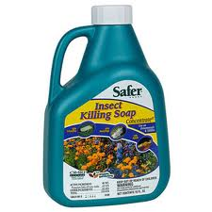


Helpful Tip
To improve the effectiveness of an insecticidal soap, mix 1 Tablespoon (15 ml) of isopropyl alcohol to 1 quart of the spray. This addition helps the soap to penetrate the insects outer shell.
It is Important to Know That Insecticidal Soap Will Kill Both Beneficial and Harmful Insects

Slide 29
LOOK… Before You Spray!
If you see signs of “The Bad” bugs in your garden take a few days before you decide to use insecticidal soap.
Use that time and a strong magnifying glass to look for The Good Bugs…give them a chance to do their job.

Slide 30

A Balanced Rose Garden
REMEMBER: By encouraging GOOD Bugs to live in your garden you can keep most insect pest populations at a minimum. This is an environmentally friendly way of controlling many garden pests.
Avoid using toxic pesticides. They kill the beneficial insects as well as garden pests.
Help the GOOD Bugs defeat the BAD Bugs by watching for signs of pests in your roses. Use the techniques we have discussed for pest control such as water-blasting, “picking and squishing”, and only when it’s really needed, use insecticidal soap.

Slide 31

We Hope You Had a Great Time Leaning About The Good, The Bad and The Bugly
SCRAM!

Slide 32
Kidz N’ Roses Wishes to Thank the Following Sources:
Bob Bauer, “Good Insects and Animals For Roses”
http://www.rose-roses.com/problems/goodanimals.html
Bob Bauer, “Bad Insects”
http://www.rose-roses.com/problems/badinsects.html
Gardenswag, “5 Common Garden Insects and Pests”
http://gardenswag.com/2011/12/5-common-garden-insects-and-pests/
Weekend Gardener Monthly Web Magazine, “Leaf Hopper Control”
http://www.weekendgardener.net/garden-pests/leafhopper-control-070907.htm
All About Rose Gardening, “Beneficial Garden Insects”
http://www.allaboutrosegardening.com/Beneficial-Garden-Insects.html
Bob Leland, “Fight Rose Pests With Beneficial Insects”
http://ezinearticles.com?Fight-Rose-Pests-With-Beneficial-Insects&id=2367610
Denise Haenel, “Lady Beetles”
http://www.fbmg.com/GardeningPages/LadyBeetle.htm
Julie Stevens, Photos
Joetta Prince, Elementary School Teacher
Terry Keiser, Teacher, Photo
Rose Brooks, Elementary School Teacher
Ginger Dwyer, High School Science Teacher

