Slide 1
Thank you for joining!
The webinar will begin shortly.
Please be patient while we allow everyone to join.
You were automatically muted once you joined the webinar.
Attendance? Don’t worry, if you are reading this, we know you are here! ☺

Slide 2
GoToWebinar
Quick Guide

Slide 3
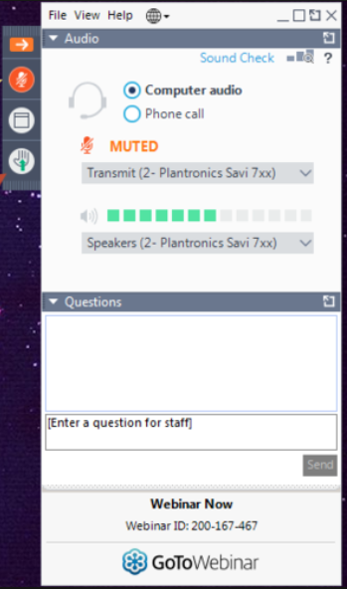
Control Panel
The orange arrow allows you to hide/unhide your control panel.
The window icon allows you to view the webinar in a pop out window so the meeting does not take over your entire computer screen.
If you have technical issues during the webinar, please raise your hand by clicking on the hand icon. If your issue is resolved before your name is called, you can click on the hand again to lower it.
You can also type your questions in the control panel under “Questions” and a staff member will assist you.
If there is background noise, you may be muted. You may have to unmute yourself when the moderator enables your microphone.

Slide 4
Polls
During the webinar, a poll may be presented. The picture to your bottom left is an example of a poll. You will select your answer, then submit. The picture to your bottom right is an example of the poll results.

